Slide 1
Executive Summary
Arindam Samanta
DSC640-T302
Bellevue University

Slide 2
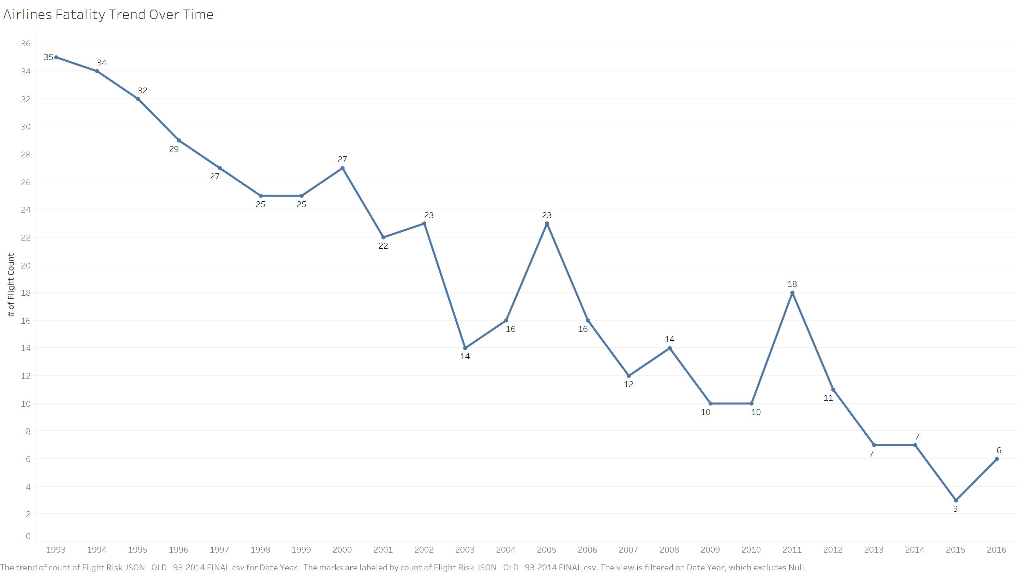
Declining Trend of Airlines Fatality
Period under consideration is 1993-2016
With few exceptions we see a general trend of declining fatality across all airlines

Slide 3
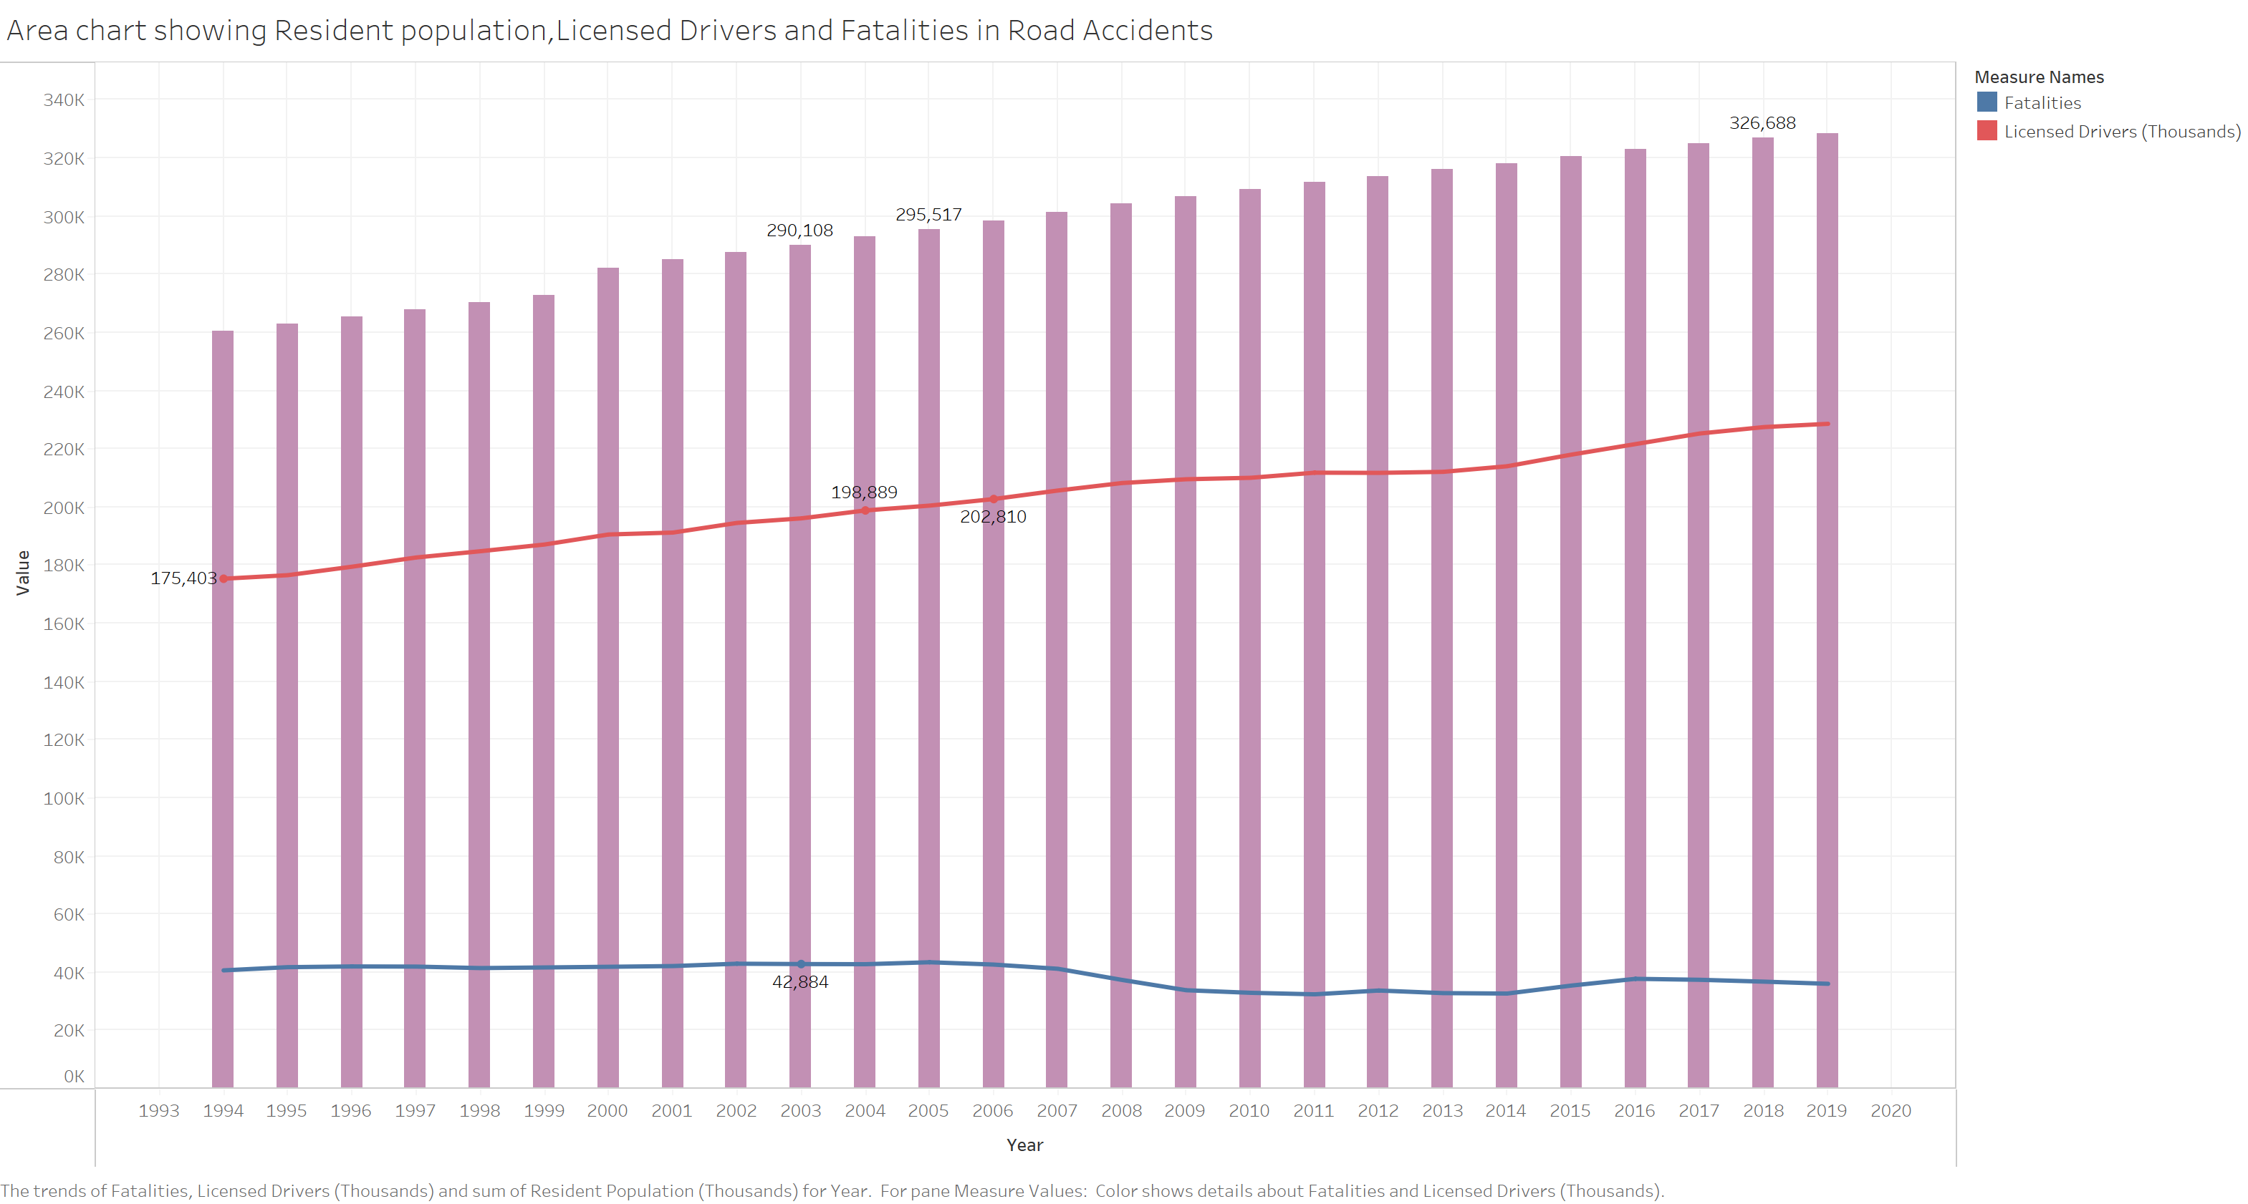
Fatality Trend Among Drivers
Period under consideration is 1994-2019
The fatality trend remains almost the same across the years
Road fatalities as percent of licensed drivers are quite high

Slide 5
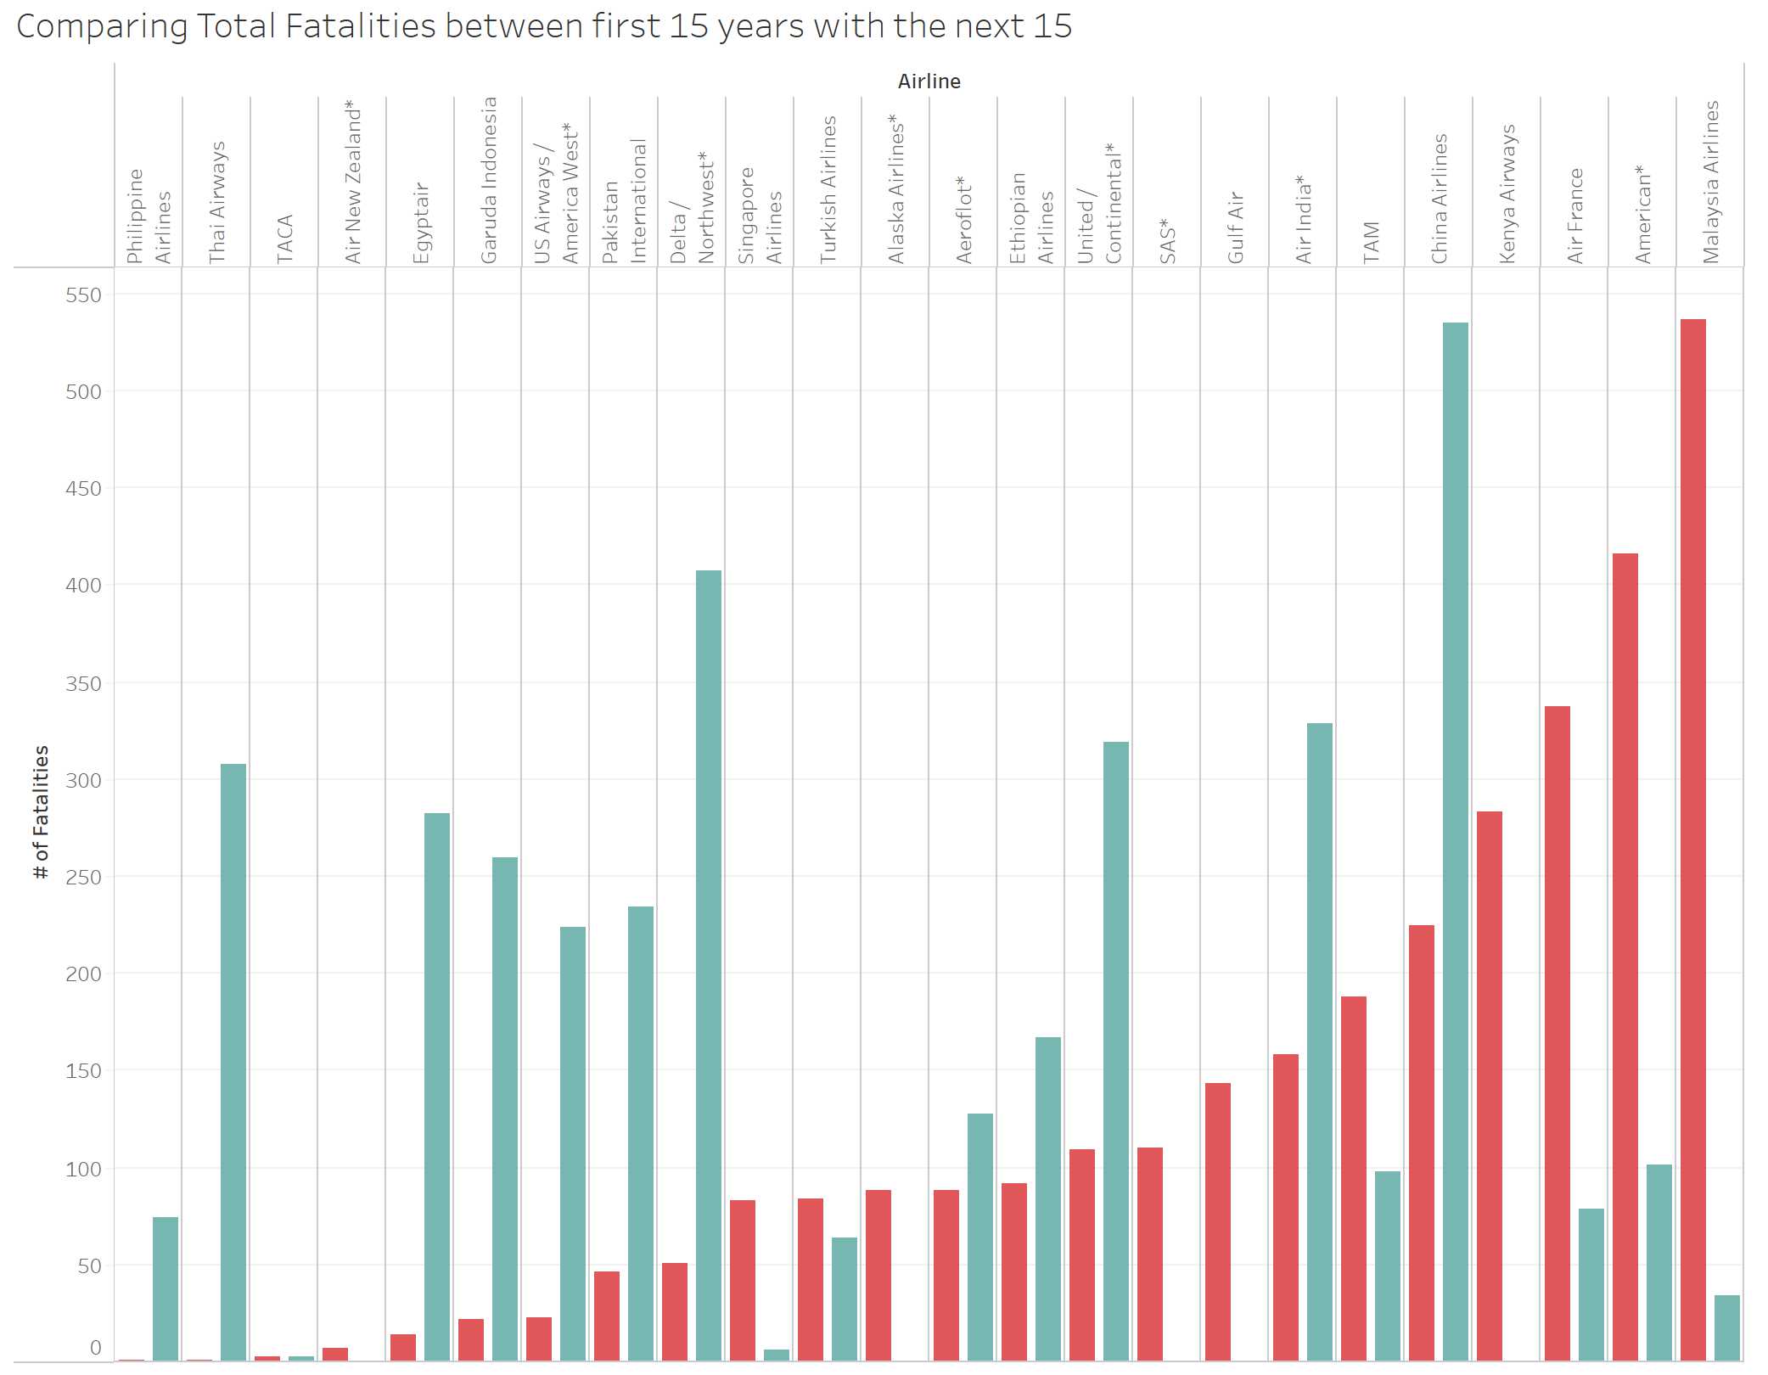

Slide 6
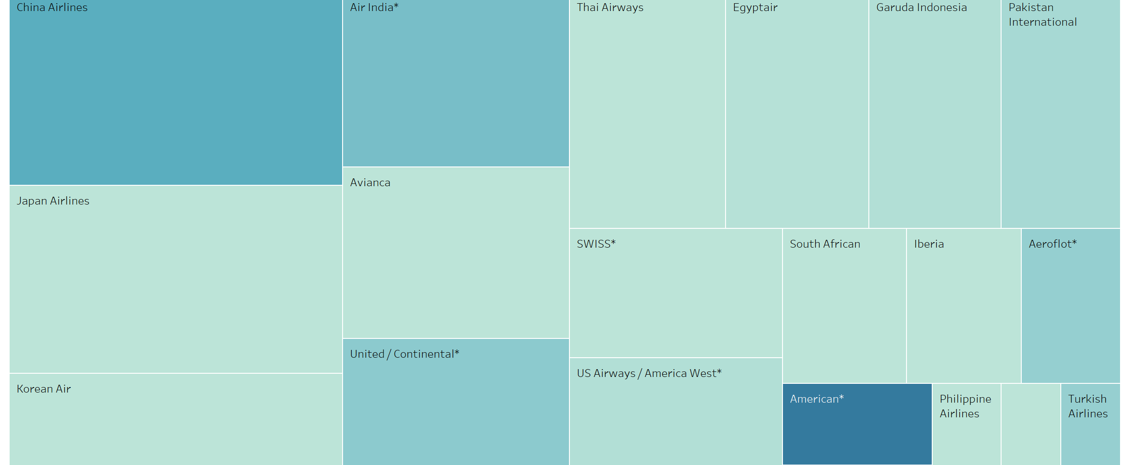

Slide 7
Main Data Source:
https://github.com/fivethirtyeight/data/tree/master/airline-safety
Supplemental Data Sources:
Motor Crashes - Downloaded from: https://www.iihs.org/topics/fatality-statistics
U.S. Air Carrier Safety Data - Downloaded from: https://www.bts.gov/content/us-air-carrier-safety-data

Slide 8
THANK YOU

